Slide 1


Acoustic MyoGraphy – CURO System and ESTiTM Score

Slide 2
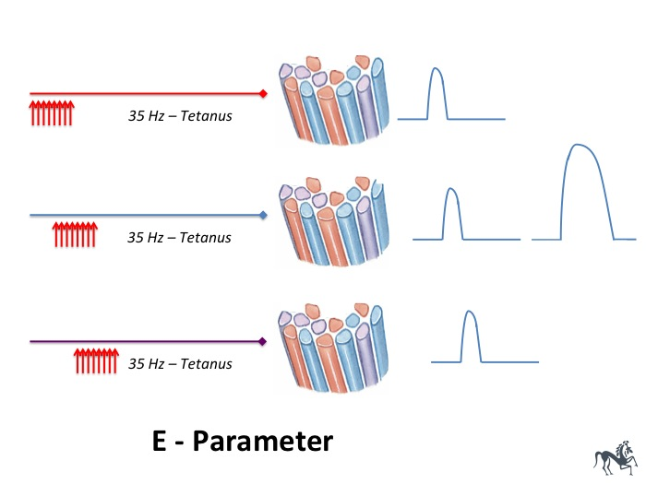
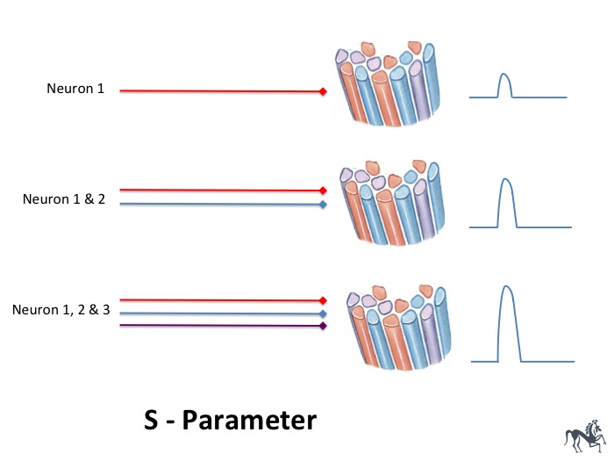
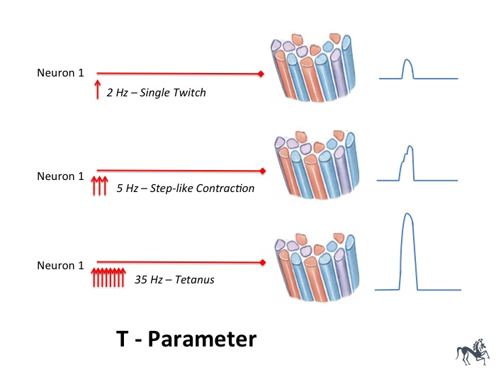
1
2
3
Improved efficiency /
coordination of active motor
units firing together
Increases muscle force
Recruitment of more
motor units increases
muscle force
A more rapid firing
rate of active motor units
increases muscle force
E-score
+
S-score
+
T-score

Slide 3
Left
Optimum
Right
E-score
10 efficient – 0 not efficient
S-score
10 few fibers – 0 many fibers
T-score
10 low frequency – 0 high frequency

Slide 4
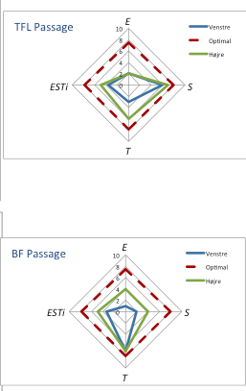
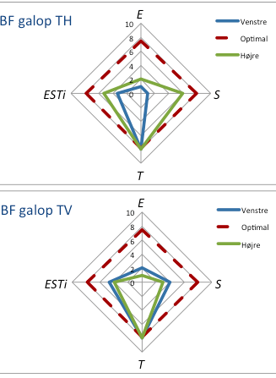
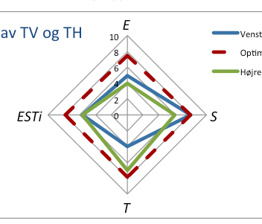
m.Biceps femoris – canter: Top – right hand circle, Bottom – left hand circle:
Note: poor coordination for both right and left hand circles (low E-score), low firing frequency (high T-score) –improved S-score for the right hand circle
m.Longissimus lumborum – trot: Note: good coordination for both right and left sides of the back (average E-score) - Left side few active fibers (high S-score) high firing frequency (low T-score) - Right side few active fibers and low firing frequency (high T-score)
m.Tensor fasciae latae – Top m. Biceps femoris – Bottom: Trot
Note: the imbalance in firing frequency in TFL (lower T-score left side) but fewer active fibers (higher S-score) for BF on the right side
Left versus Right
Muscles

Slide 5
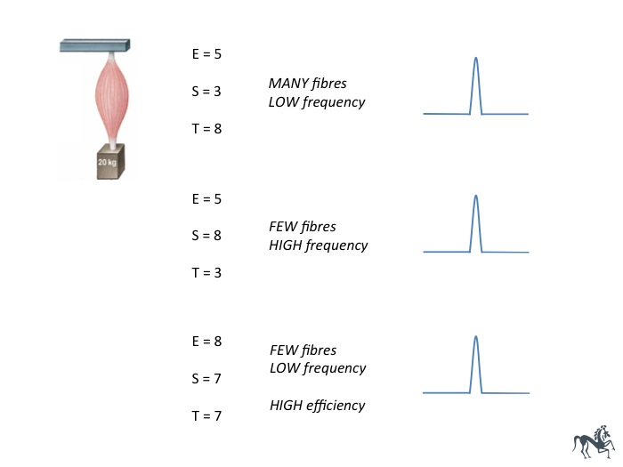
The central nervous system can determine precisely the force generated by a skeletal muscle by determining the number of active muscle fibres (S-score), the rate with which they contract (T-score) and the efficiency /coordination of synchronization (E-score) – all represented by the ESTiTM-score measured using the CURO system.

Slide 6
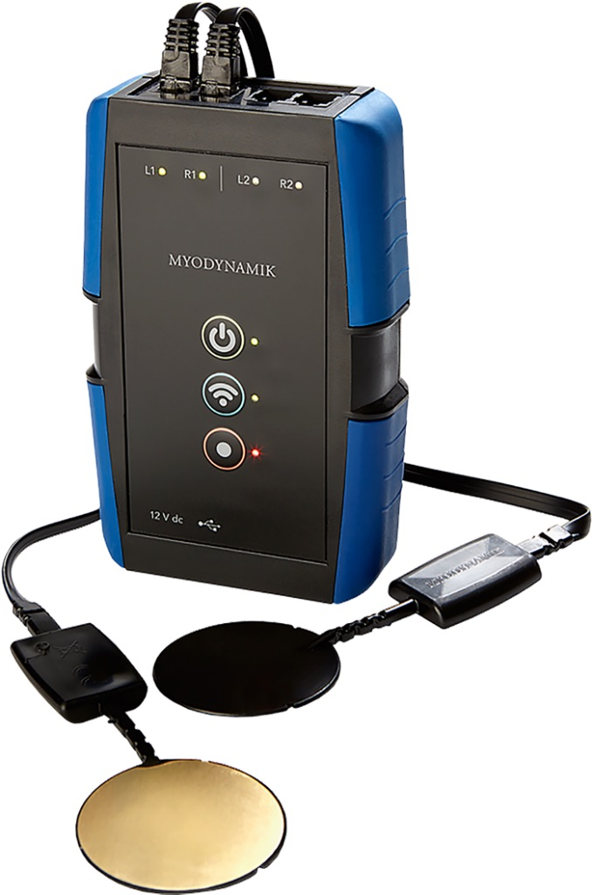
Thorvaldsensvej 19, 2.th, 1871 Frederiksberg C,+45 61462732
myodynamik@myodynamik.com www.myodynamik.com

