Slide 1

CURO Equine App
User Guide
1st March 2017
www.myodynamik.com

Slide 2

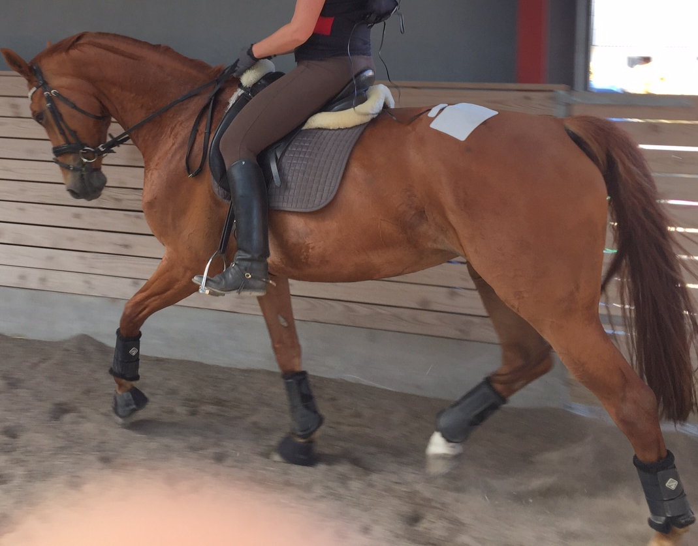
CONTENTS
ESSENTIALS p. 3
LOGIN & SETUP p. 4
EQUINE p. 10
SENSORS p. 17
CURO CONNECTION p. 18
CURO RECORDING p. 22
SIGNALS & PATHWAYS p. 26
CLIENT CLOUD ACCOUNT p. 27
PROBLEMS – TROUBLESHOOTING p. 35

Slide 3
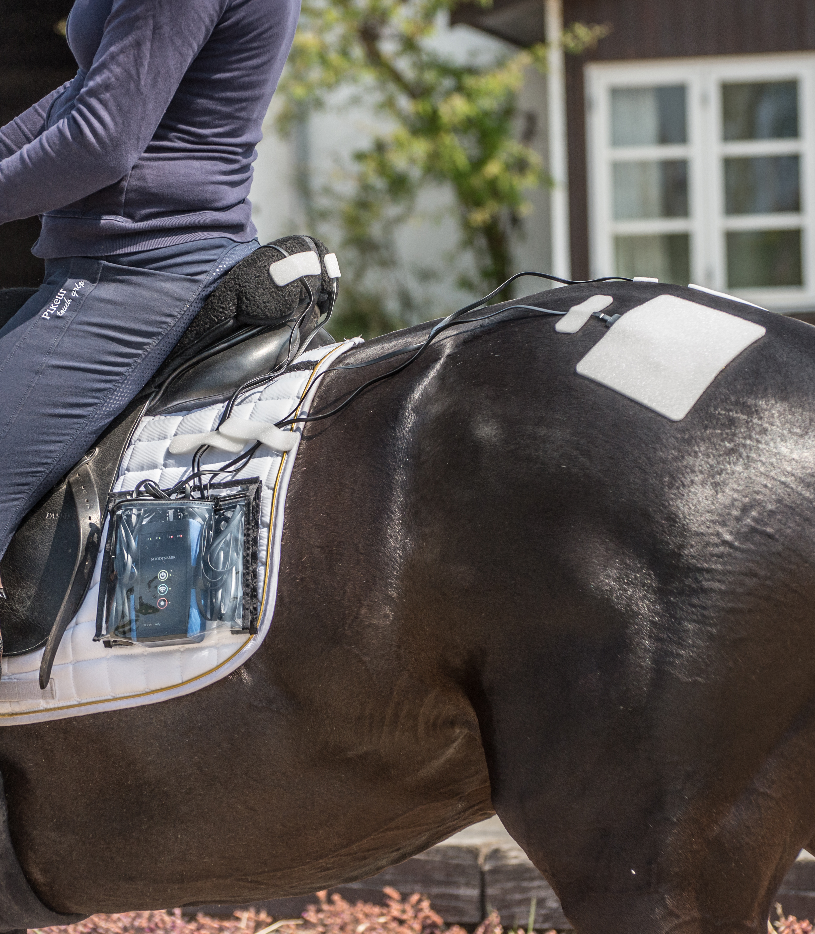
ESSENTIALS
SIM Card – for your CURO system to work you NEED an iPad that has a SIM card and internet connection.
  This is essential since the CURO system takes advantage of the latest updates in muscle anatomy and in algorithms every time you switch on and login to your CURO – a process that requires considerable amounts of data transfer and would be too time consuming via a WiFi connection.
  You will also need to transfer your own recorded data to your Client Cloud Account and this is achieved using an internet connection – once again a WiFi connection would be too time consuming.
HEAT – make sure your CURO is not exposed to high environmental temperatures (>105ºF / 40ºC) as this affects the WiFi connection.
    If your CURO is left out in direct sunlight during periods of high environmental temperature, the WiFi connection with your iPad will be affected.
COLD – make sure your CURO is not exposed to extreme cold environmental temperatures (-5ºC) as this affects the WiFi connection and the battery life of the CURO.

Slide 4
LOGIN & SETUP (1)
Switch OFF the WiFi in Settings but make sure that you have an internet connection running (3G/4G etc.).
Click on the CURO Equine App icon and it will initialize, revealing the MyoDynamik icon for a few seconds.

Slide 5
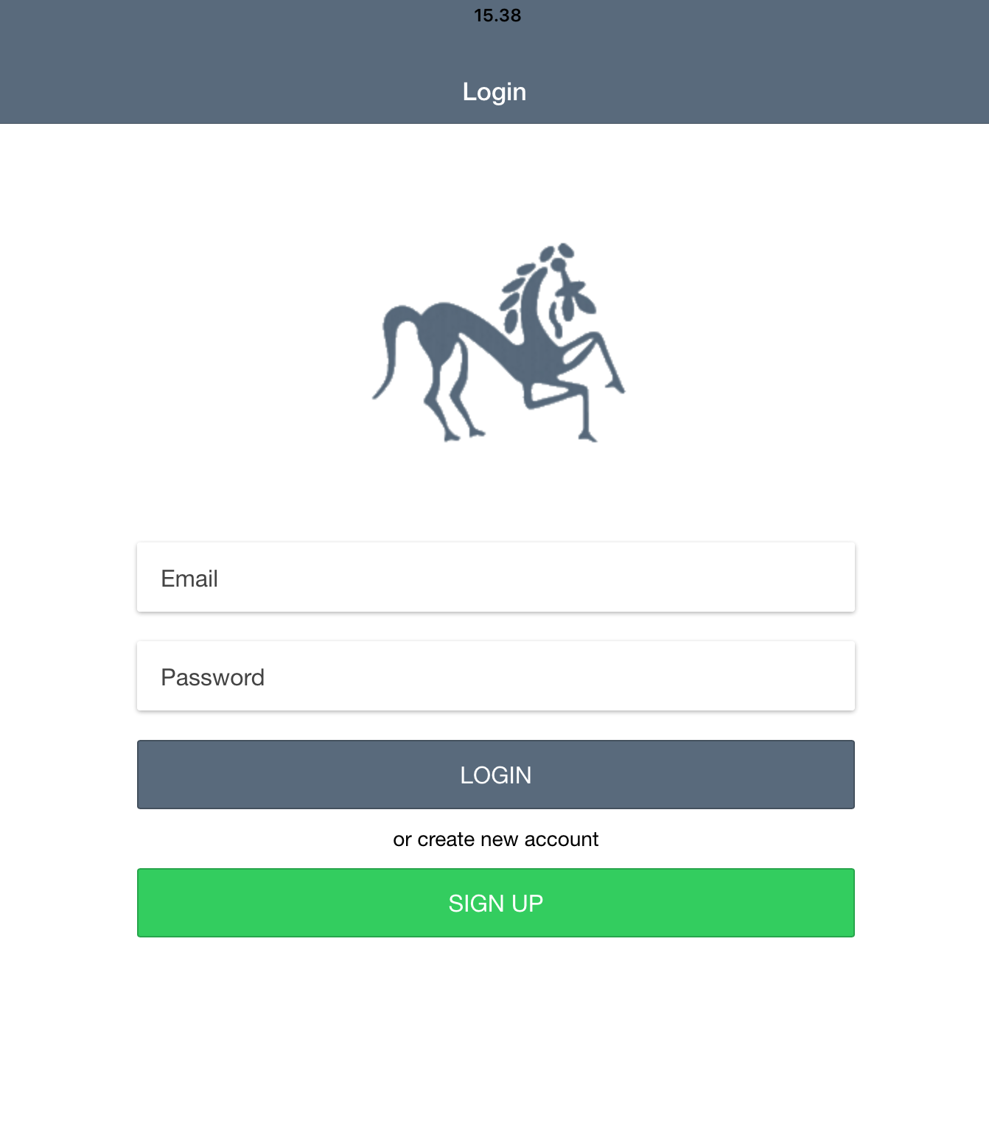
LOGIN & SETUP (2)
Enter your e-mail address – the one that you have either sent to MyoDynamik, or the one you have been assigned.
Enter the Password.
If this is the first time you are using the CURO Equine App, then the password is most likely
123456789
Press the Enter button.

Slide 6
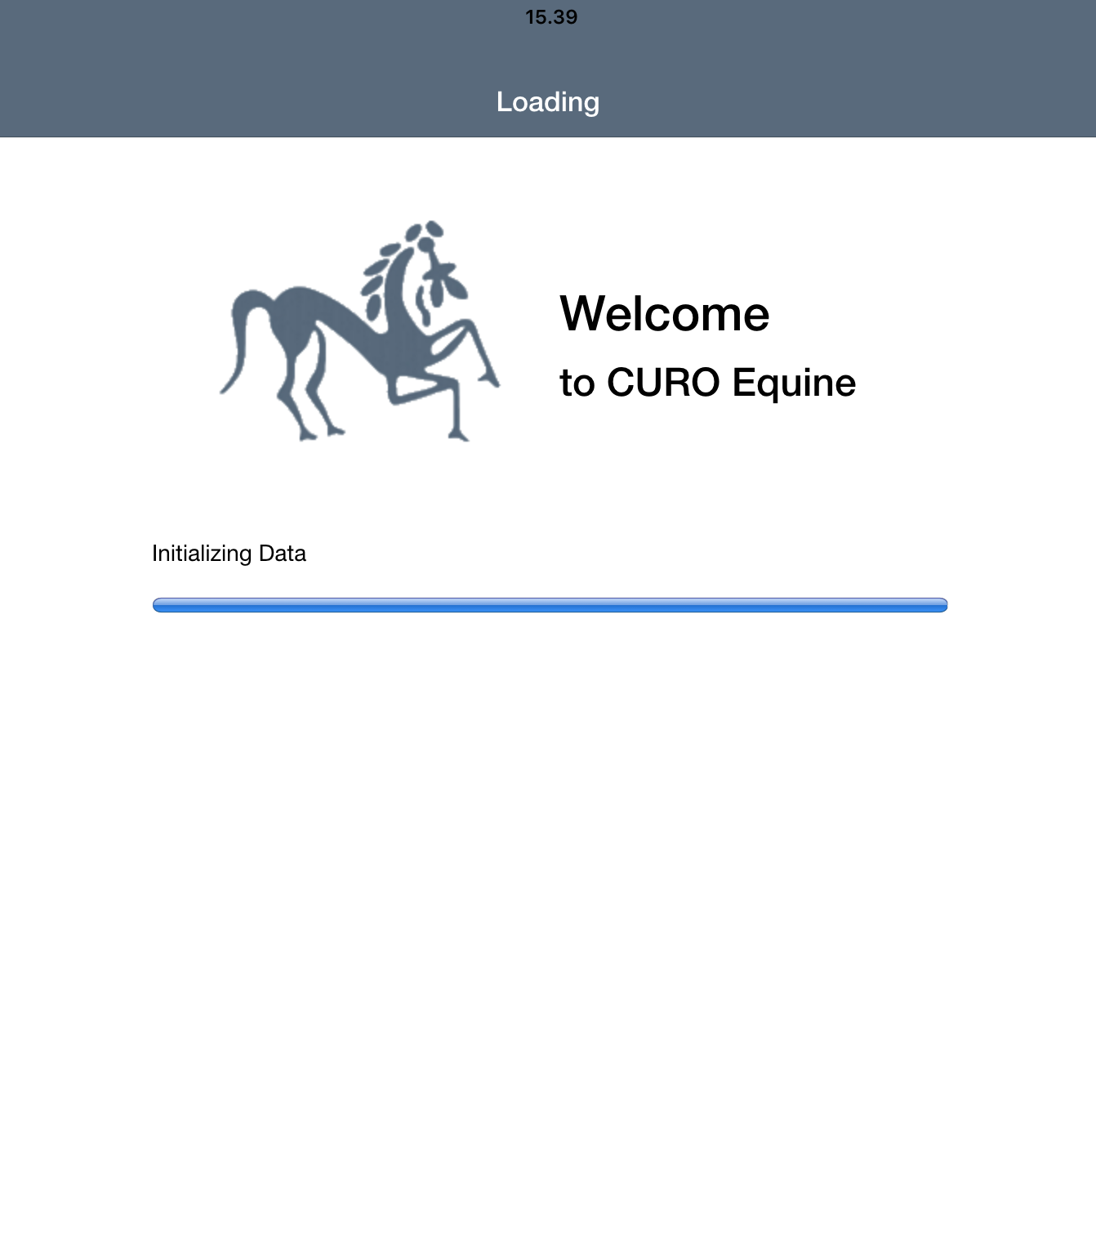
LOGIN & SETUP (3)
The CURO Equine App will now initialize. This may take a few seconds as the CURO Equine App downloads the large image files and the latest algorithms needed to run the acoustic myography recordings.
NOTE: the files are too large to be downloaded quickly using a WiFi link – hence the initial need for an internet connection.

Slide 7
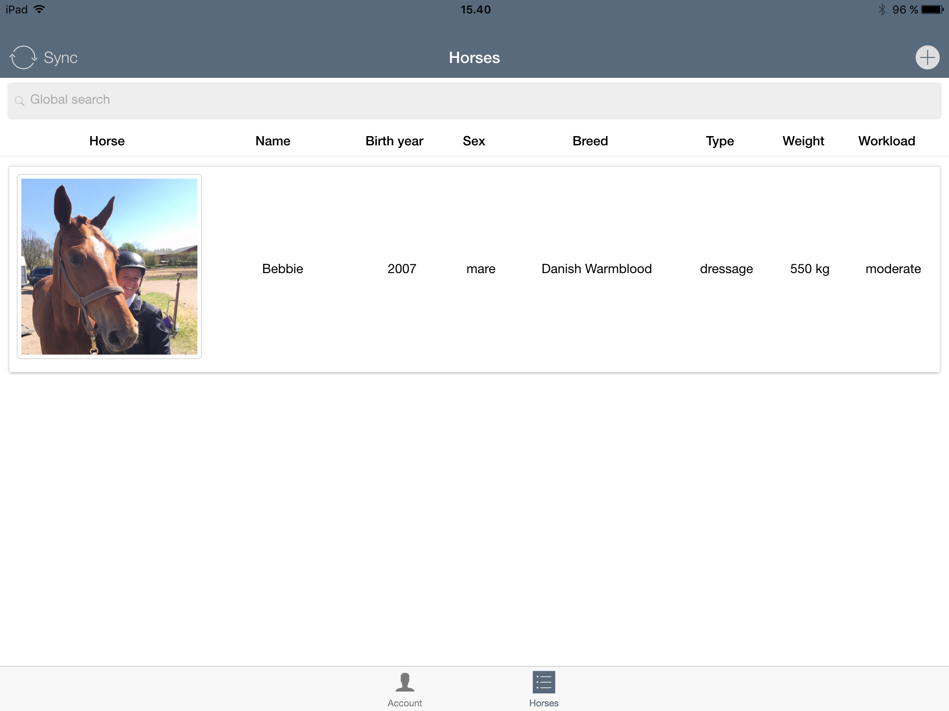
LOGIN & SETUP (4)
Once the App has initialized, you will arrive at the Horses Page.
On the Horses Page you can add or edit a horses details
At the bottom of the screen you will find a small icon in the shape of a human head with shoulders below which is the word Account.
  Press the account icon if you wish to:
  Check your account details
  Change your password
  Logout

Slide 8
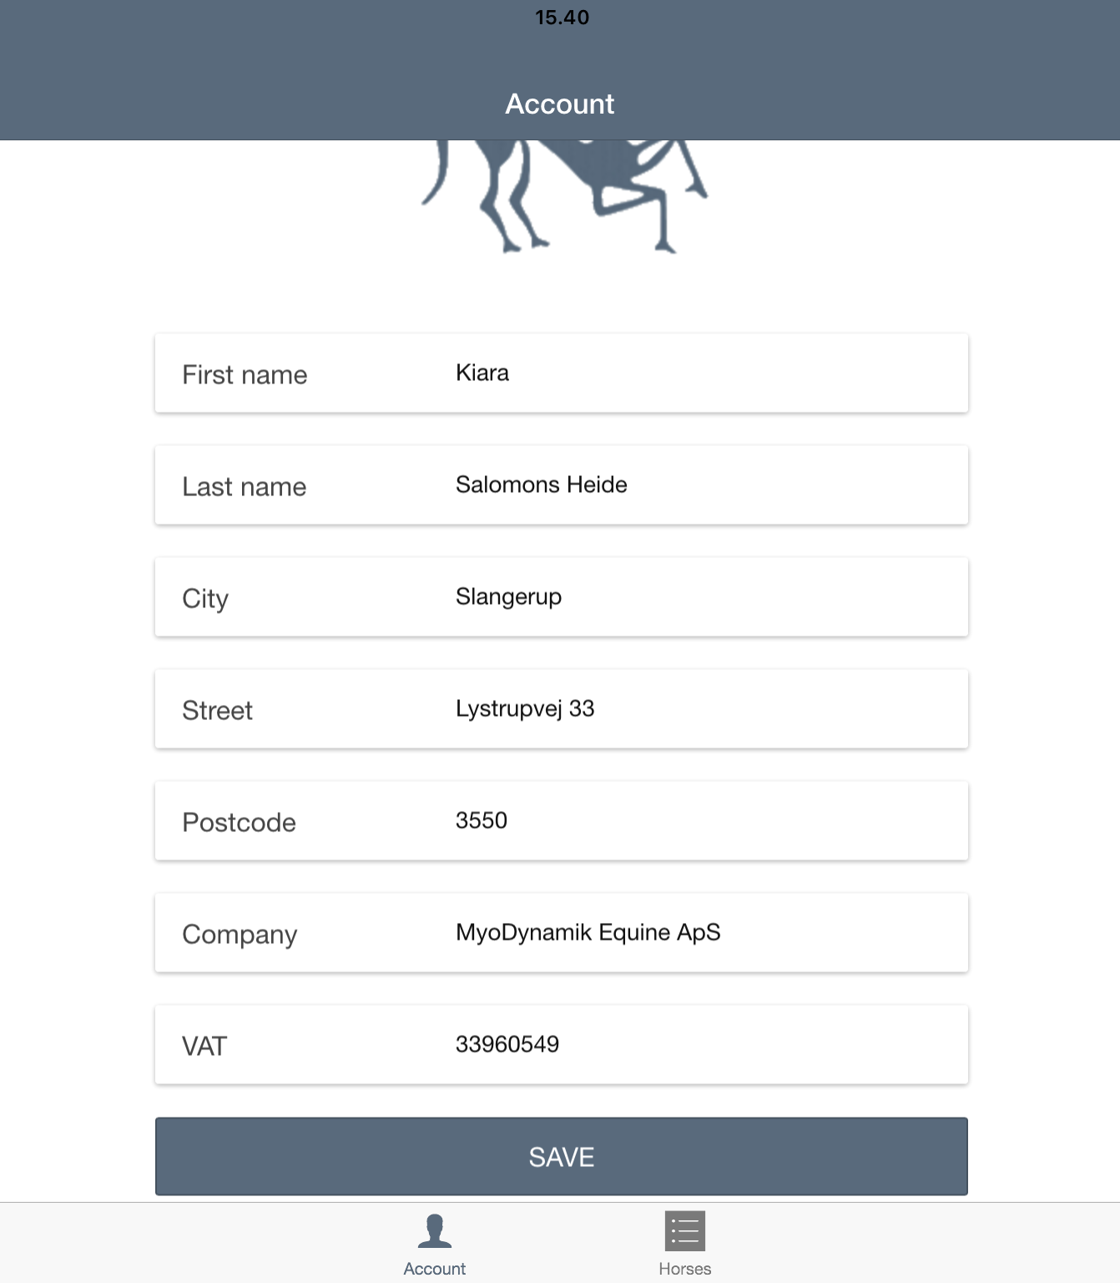
LOGIN & SETUP (5)
Having pressed on the Account icon, you can check and change your account details. Do remember to Save any changes you make.
It is also here that you can change your password – press the Change password text:
  Enter your old password
  Enter your new password
  Repeat your new password
  Press Save
Use the Account button in the top left corner to return to the previous screen.
Having pressed on the Account icon, you also have the possibility to Log Out (press the red bar to do this).
  NOTE: if you have unsaved data on your iPad, then a warning message will appear telling you that a Log Out will result in the loss of any un-’sync’ed data.

Slide 9
LOGIN & SETUP (6)
In the top left hand corner of the Horses page you will find a double arrow circle with the word Sync next to it.
If you press Sync whilst you have an internet connection and your WiFi is switched off, then the data you have recorded on your iPad will be sent to your Client Cloud Account to be stored and analyzed.
  Remember to record short sequences of data for each movement – the system cannot easily transfer large files.
In the top right hand corner of the Horses page you will find a circle with a + symbol – press this if you wish to add a new horse.

Slide 10
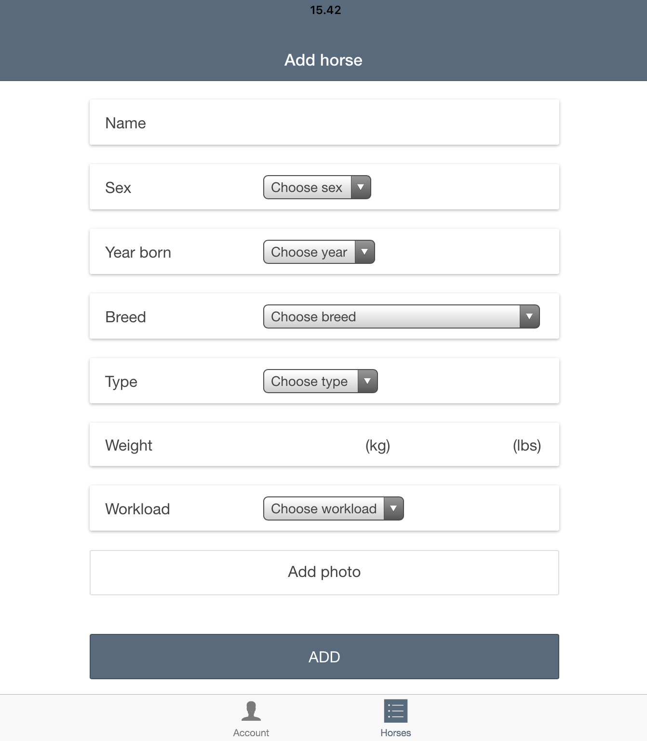
EQUINE (1)
To add a new horse, you simply enter the horses name, sex, birth etc.
At the bottom of the page you can add a photo of the horse by pressing add photo. Either use a photo in the library or take a photo right away and then select it from the Photos on your iPad.
  It is not essential to add a photo, you can proceed without this feature if you wish.
Press Save to store the new horse under your list of horses on the Horses page.
– or press Cancel if you do not wish
to proceed with this task at the present time.
NOTE: It is necessary to type in something for all the information boxes. It can always be edited or changed at a later date.

Slide 11
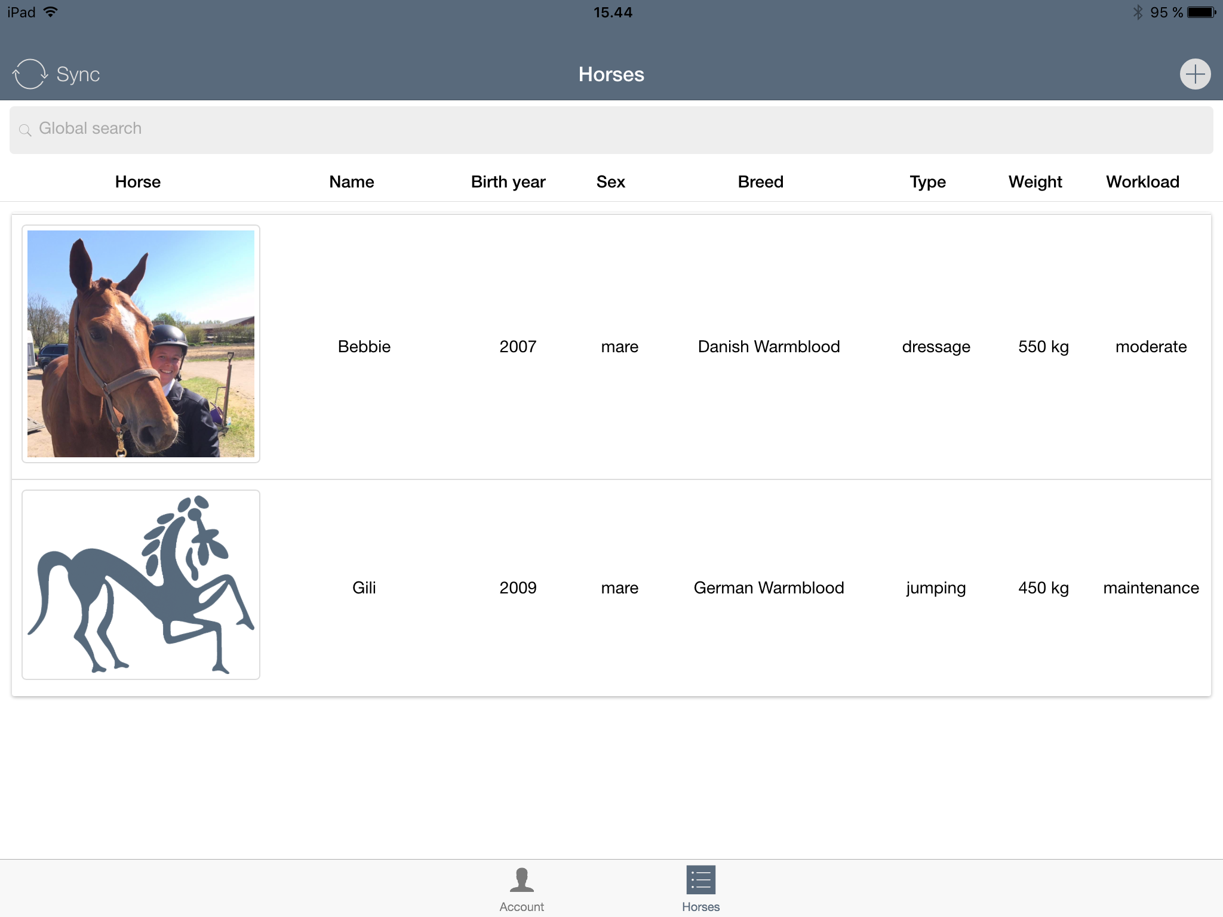
EQUINE (2)
Having assigned a new horse, the identifier of this horse will appear on your List of Horses page.
You can proceed to add as many horses as you wish by simply follow the same procedure as outlined: Start by pressing the + symbol in a circle found at the top right hand corner of the List of horses page.
  Tip – if you have time and a good internet link then quickly sync your added horses before proceeding to take a measurement.

Slide 12
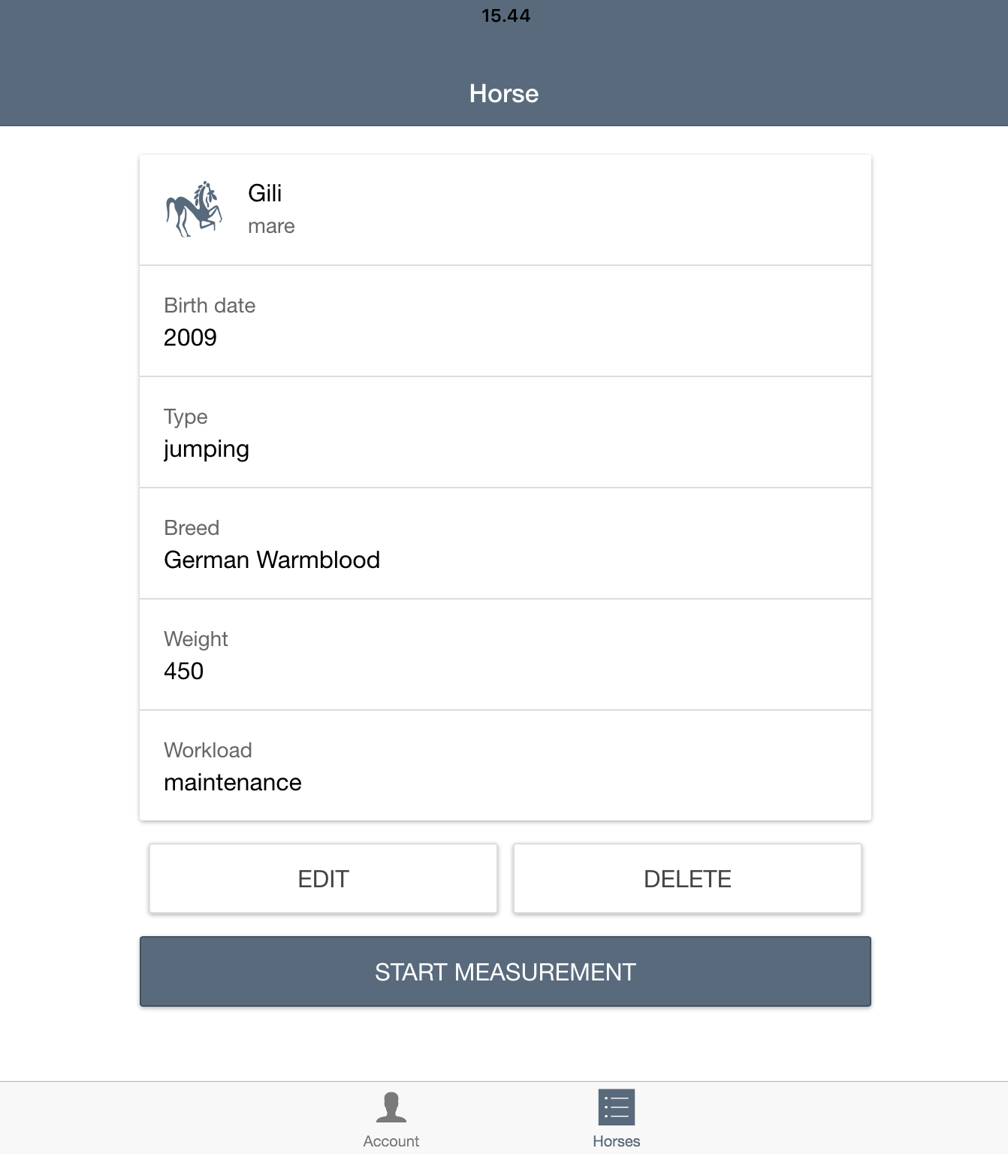
EQUINE (3)
Now press the horse you would like to measure. The details for this horse will appear.
In this case ‘Gili’ has been
chosen.
Here you can edit or delete the horse if needed.
If you wish to make a measurement, then press “start measurement”

Slide 13
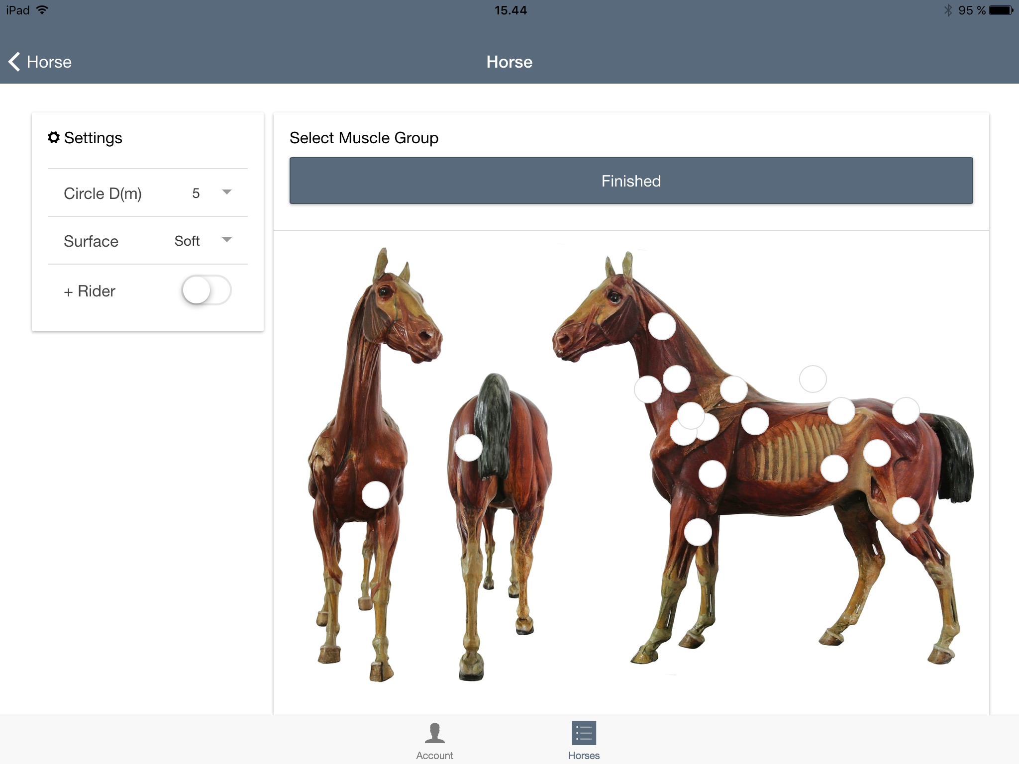
EQUINE (4)
Select a muscle group, or muscle groups (a total of 2 muscle groups can be assigned per CURO). You do this by touching the white circle on the equine muscle anatomy drawing to be found on this page.
It is a good idea to determine which muscle group is to be assigned to which channel on the CURO. For example, gluteus medius to be recorded on channels L₁ and R₁ and triceps on channels L₂ and R₂ – where L denotes left-side and R denotes right-side.

Slide 14
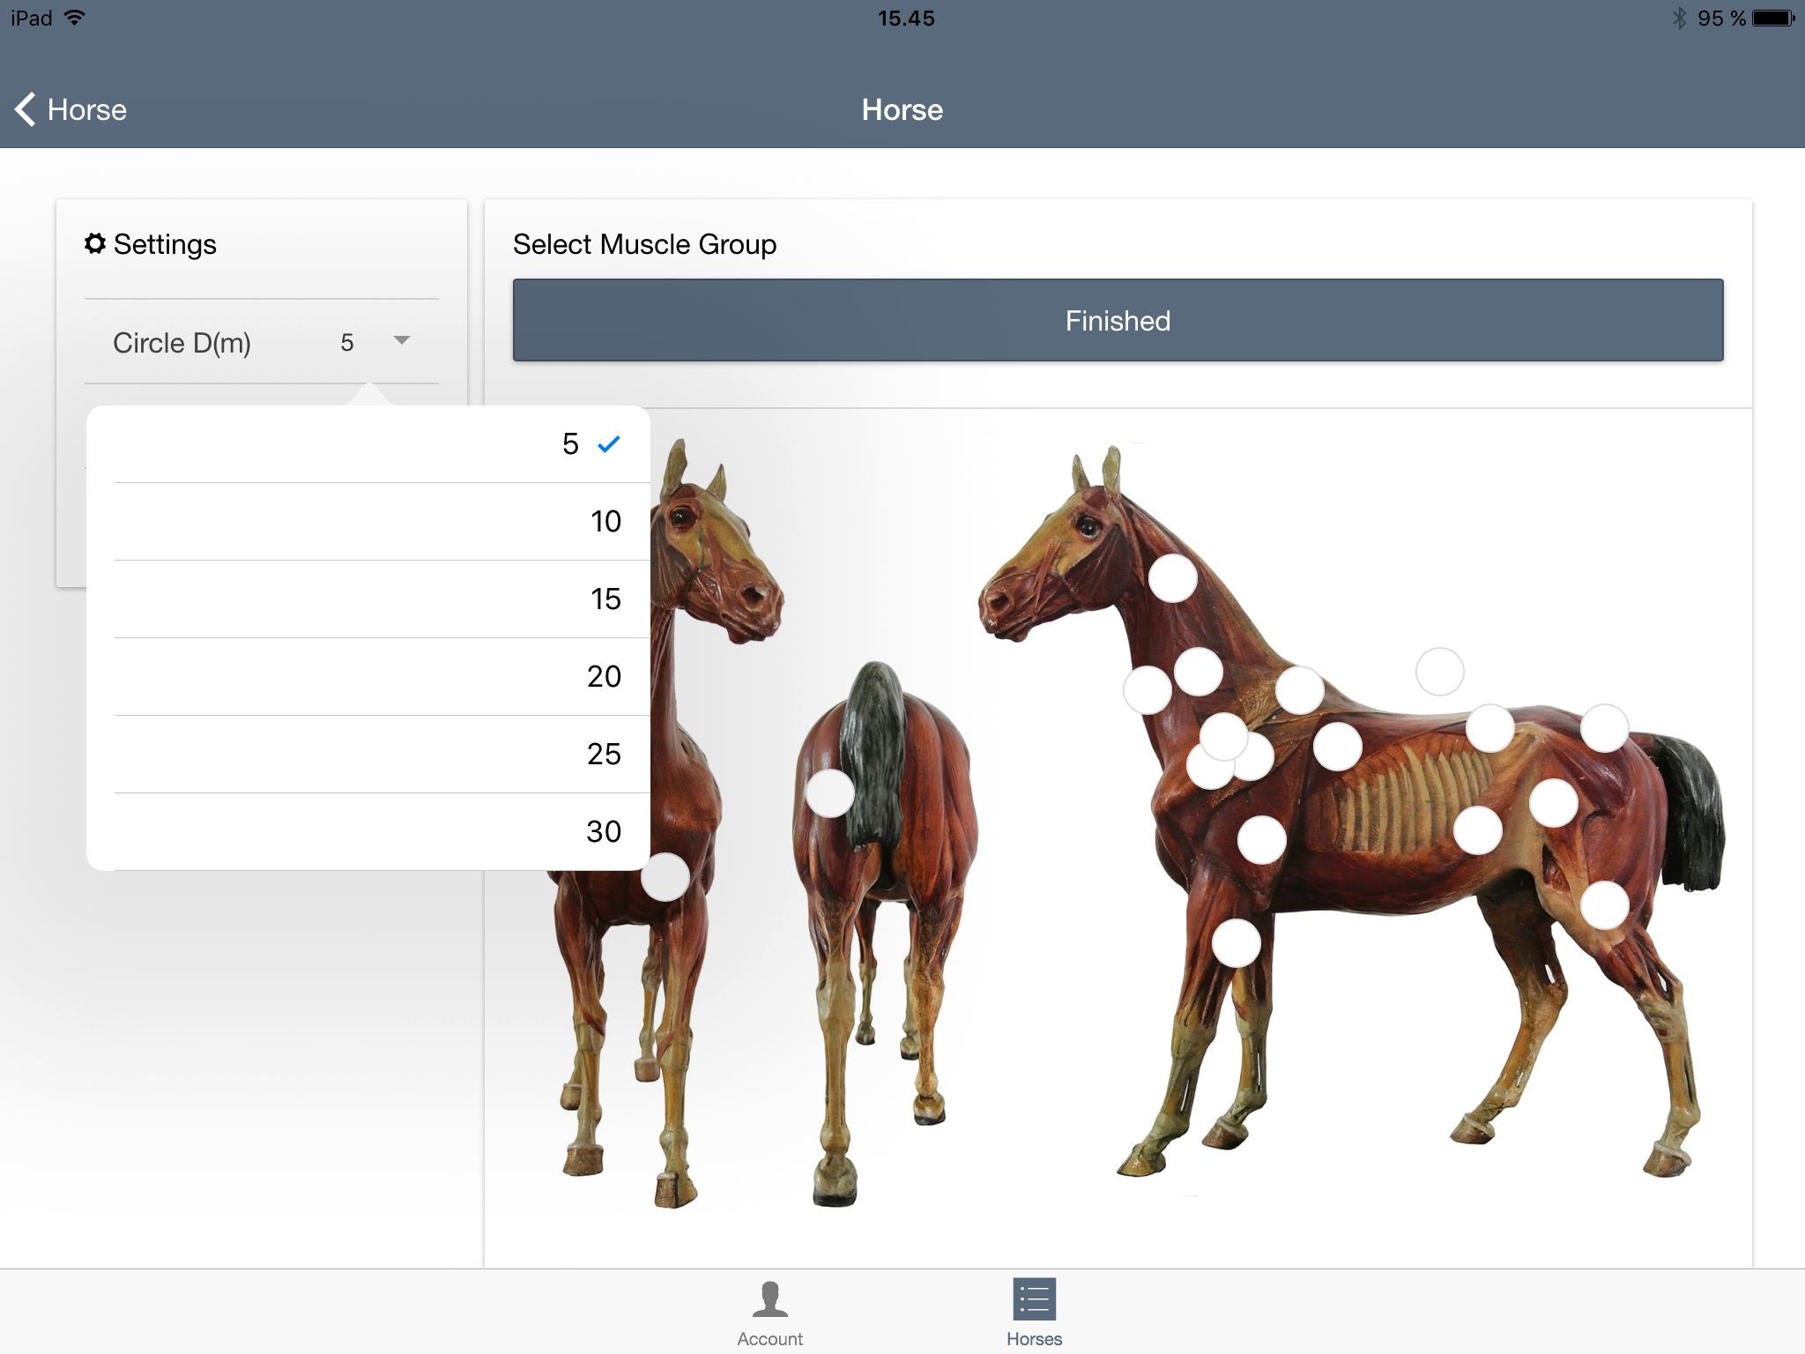
EQUINE (5)
Now choose the diameter of the circle if the horse is to be exercised in this way.
If the CURO is to be used during riding, then simply select the Rider button.

Slide 15

EQUINE (6)
Having chosen a muscle group, you will note that the white circle changes colour, and a number will appear inside the circle to denote which muscle group has been selected:
  1 denotes channels L1 and R1
  2 denotes channels L2 and R2
On the left hand side of the page you will find a list of the muscles assigned to this test – by way of confirmation. You can deselect them and select others at this stage if you so wish.
Alongside the number and name of the selected muscle group, you will find a small light blue circle with the letter i inside. Press this circle for detailed information about the selected muscle, as well as visual cues as to where to place the sensors.
Press the Finished bar to start a measurement.

Slide 16
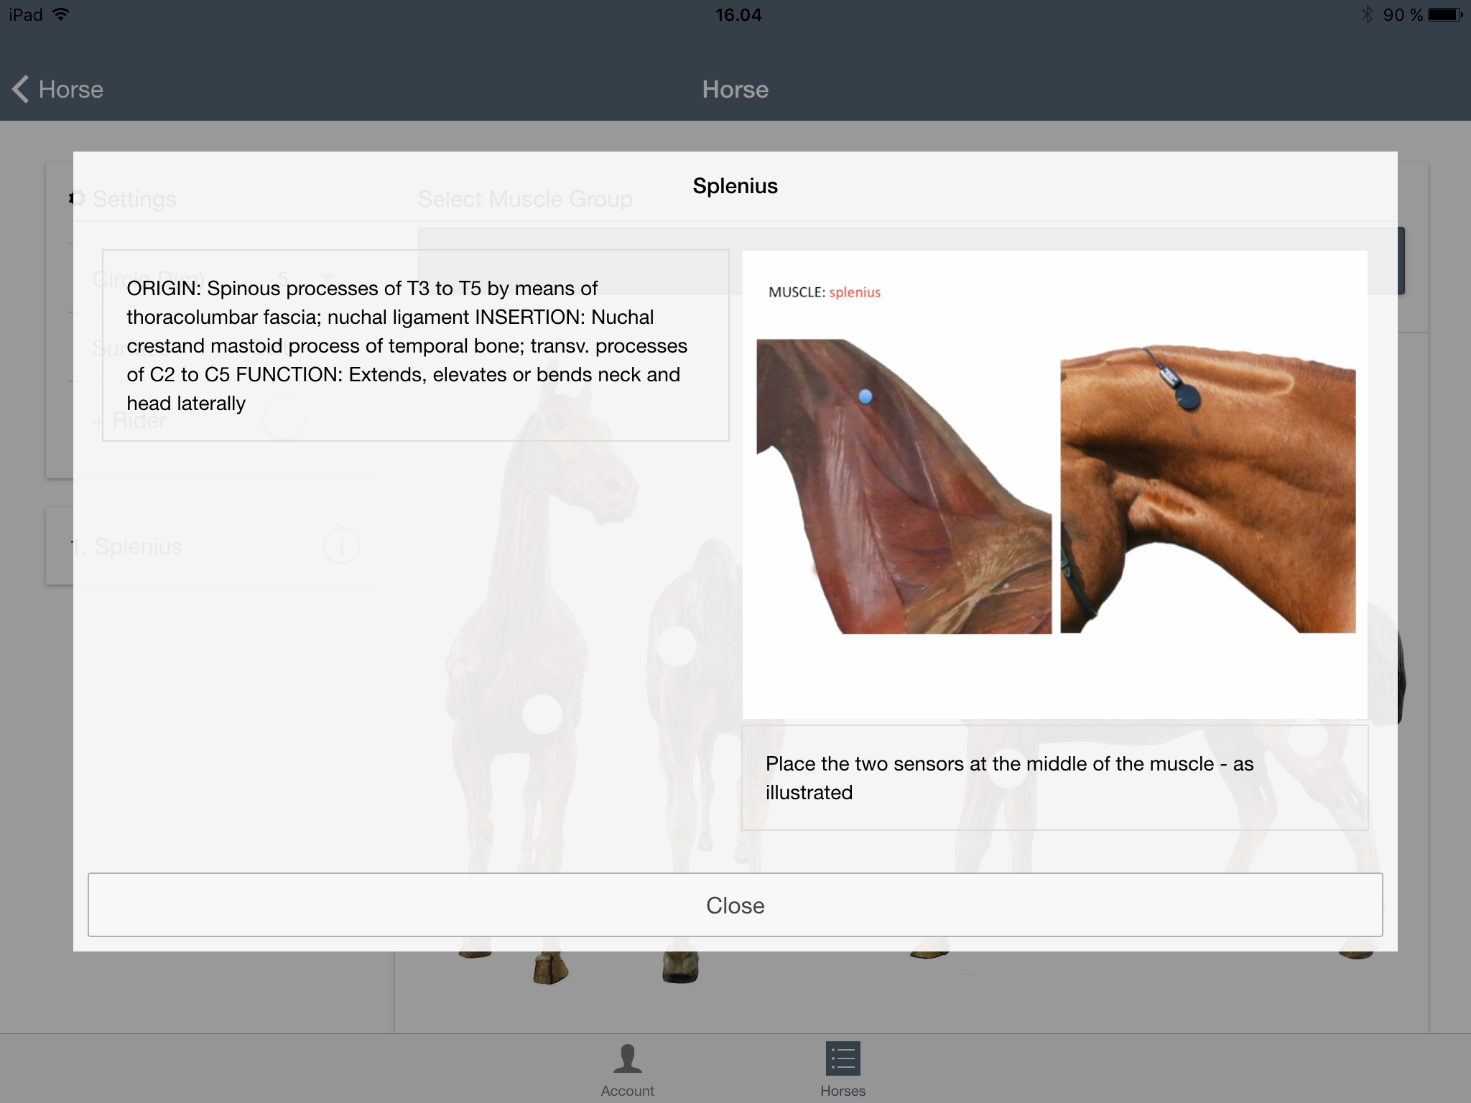
EQUINE (7)
Having pressed the light blue circle with the letter I inside for the selected muscle group, a pop-up window will appear on the screen.
The pop-up window provides you with details regarding the Origin, Insertion and Function of the selected muscle group.
The pop-up window also shows you a more detailed image of the muscle anatomy and a suggested placement for the CURO sensor.
Press the Close text at the bottom of the pop-up window to remove this information.

Slide 17
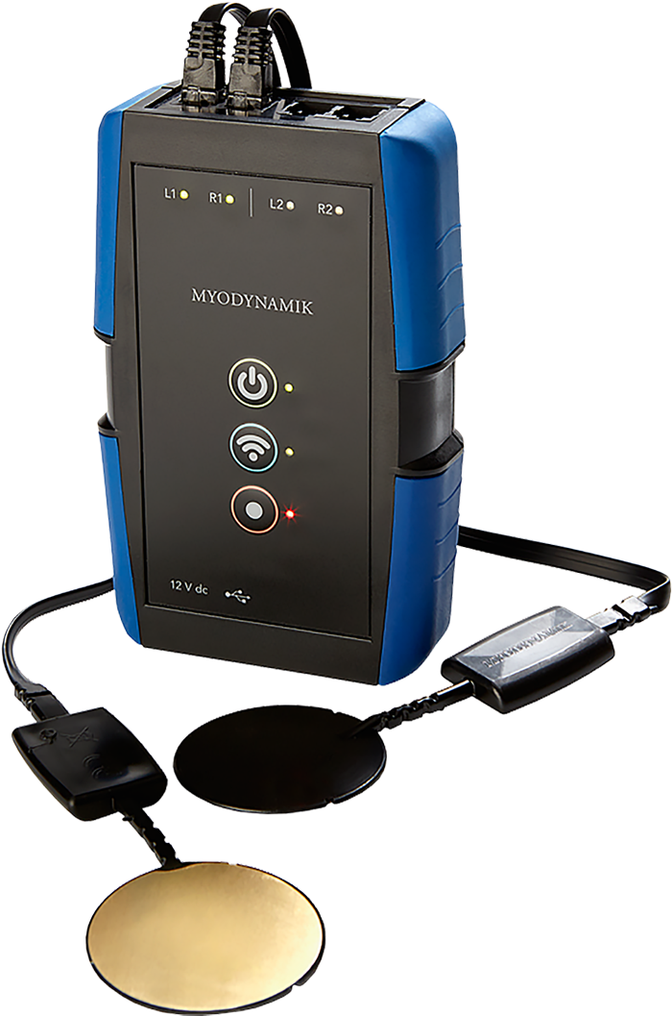
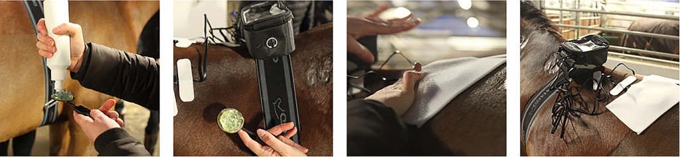
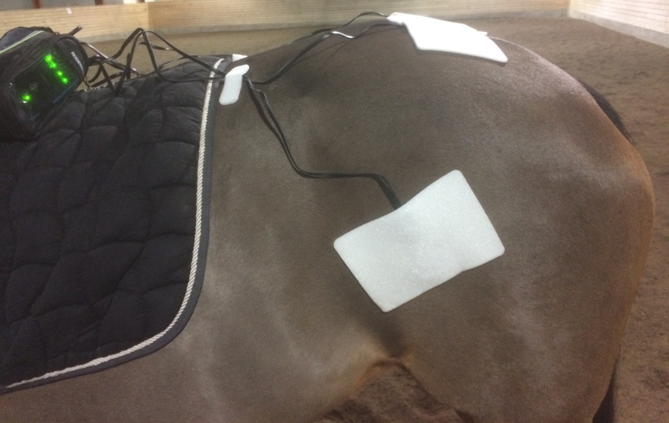
SECURING THE CURO SENSORS (1)
The following forms a recommended procedure to adopt in order to secure the CURO sensors to the selected muscles of your horse:
Secure the CURO to the horse, either on the girth or in the pocket on the saddle pad. Turn on the CURO and the WiFi connection.
Locate the muscle you want to measure. You can use the app to guide you to the right position.
Put a little gel on the horse at the selected site – rub well into the hair. Try to locate the exact spot on the other side of the horse, so that muscles left and right are measured at the same anatomical spot – this ensures accurate results.
Prepare the Snögg (adhesive foam bandage). Take out the sensor and apply a thin layer of gel all over the sensor and rectangular housing, then apply ca. 1/2 cm of gel to the shiny metal side of the sensor.
Place the sensor on your chosen spot and gently secure with the Snögg so that it completely covers the sensor.
Click the sensor into a vacant channel slot on the CURO. NOTE - remember to connect the sensor according to muscle and left- or right-side (L1, R1, L2, R2).
Repeat on the other side of the horse. Secure any loose wires with the small pieces of Snögg provided so that the horse is not scared during the measurement.
Press record on the CURO as and when needed (see how to use the CURO app, under CURO app instructions)
Now you are ready to use your CURO

Slide 18
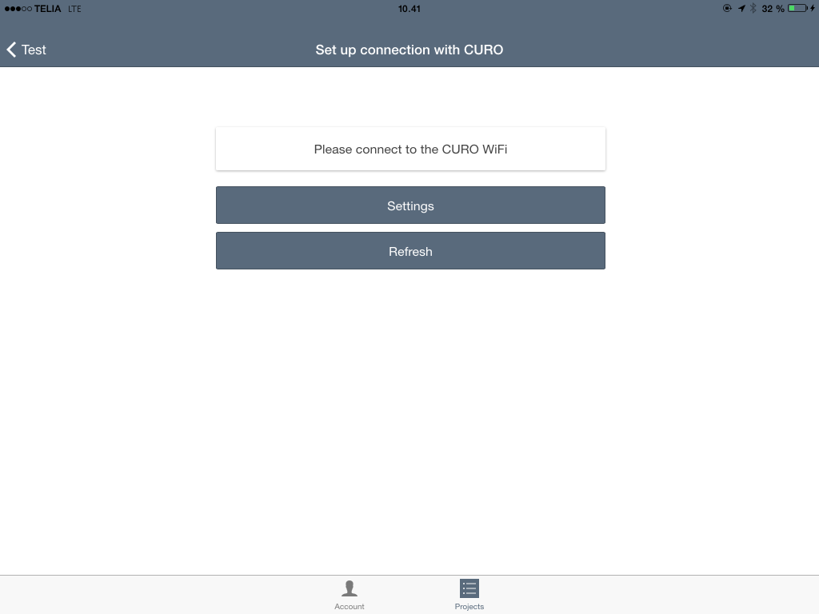
CURO CONNECTION (1)
The “Set up connection with CURO” page allows you to interact with the CURO using the WiFi link the CURO provides.
Having secured the CURO sensors to the horse, and attached the sensors to the CURO – make sure:
  That the CURO is switched ON
  That the WiFi on the CURO is ON
  That you are recording on the CURO if you also wish to have a WAV file you can analyze later.
Press the Settings bar to start the WiFi connection with the CURO.

Slide 19
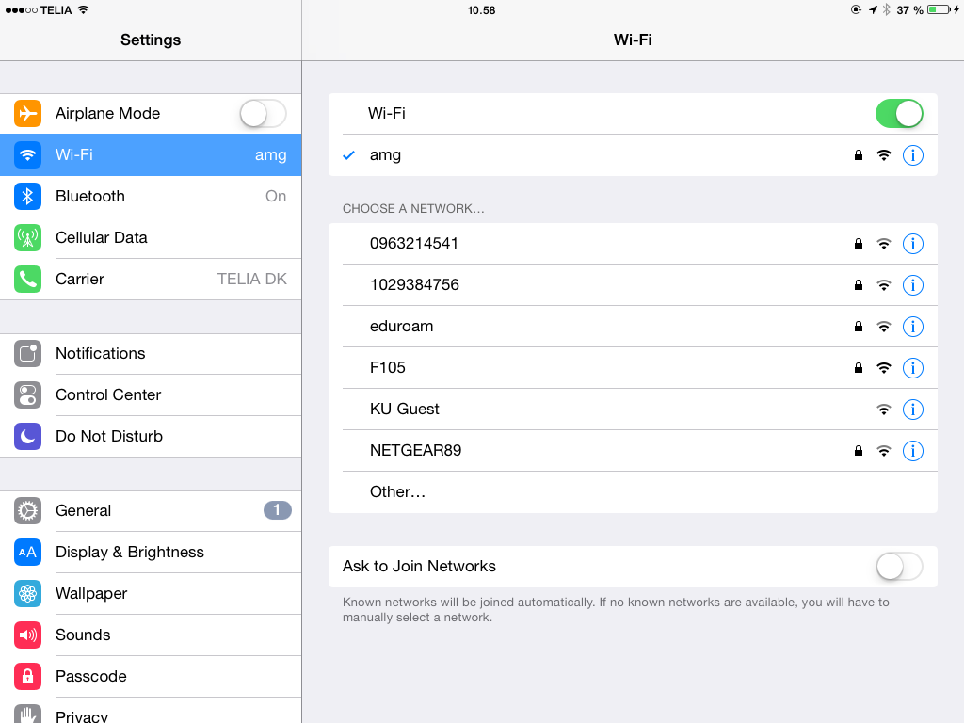
CURO CONNECTION (2)
When you press the Settings panel, you will be directed out of the CURO Equine App and into the iPad Settings program.
Scroll up to find the Wi-Fi function and activate it.
A WiFi device called amg should appear on the list of networks – assuming that the WiFi button on the CURO has been pressed and a green light is visible on the CURO next to the WiFi button.
Select the amg network and if asked for a password then use:
  123456789
Having established a WiFi link with the CURO (blue tick next to amg), leave the Settings program on your iPad and re-enter the CURO Equine App.

Slide 20
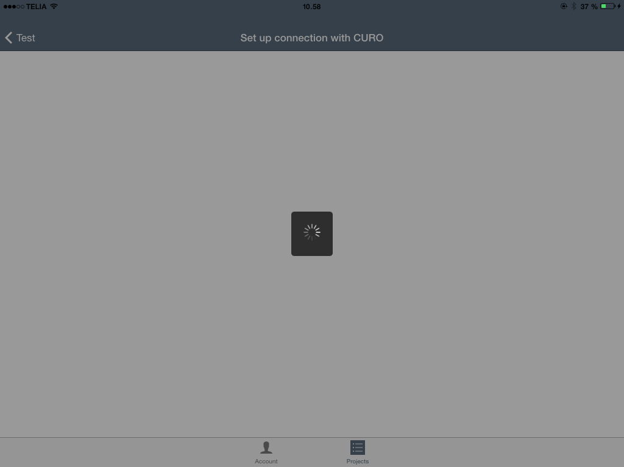
CURO CONNECTION (3)
Upon re-entering the CURO Equine App your iPad screen may look like this for a few seconds.

Slide 21
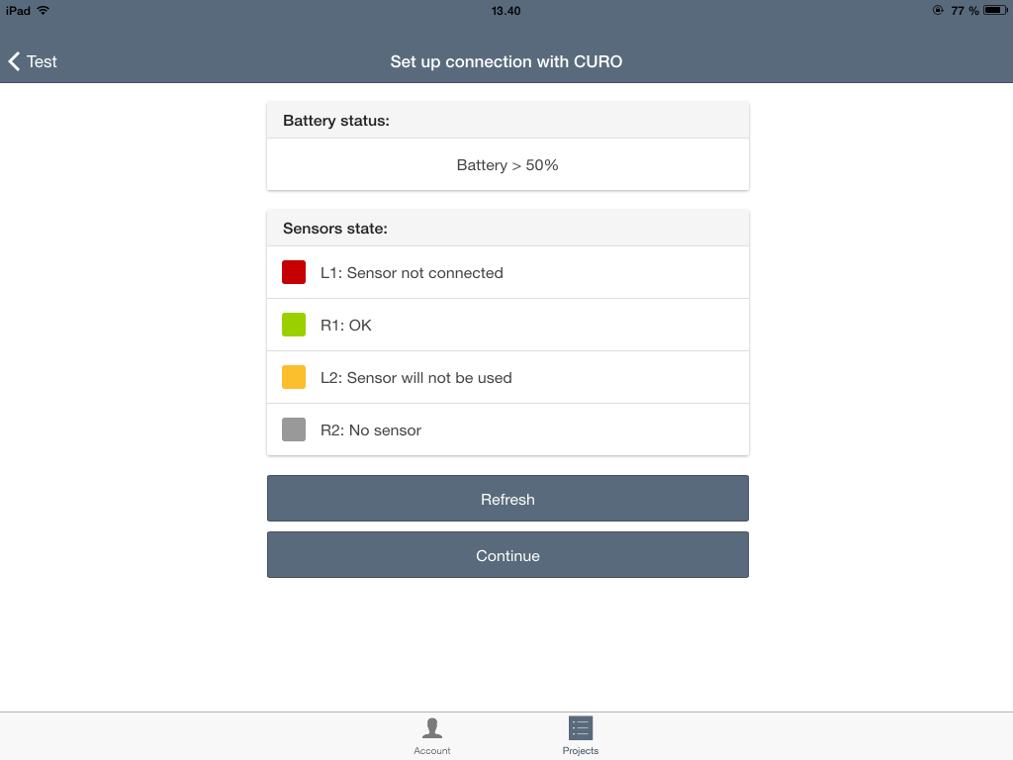
CURO CONNECTION (4)
The ‘Set up connection with CURO’ page on your iPad should now reveal the following information:
  Battery life >50% indicates that the CURO is more than 50% charged.
Sensor state:
  A red square indicates that the sensor has been attached improperly (try to remove and re-insert the sensor) or that a faulty or expired sensor has been attached (remove and exchange the attached sensor for a new sensor).
  A green square indicates a functional sensor.
  An orange square indicates that a sensor has been attached to L2 or R2, but only one muscle have been chosen. If only one muscle is to be measured then the CURO prefers prefers to use channels L1 and R1
  A grey square indicates that a sensor has not been attached.
If you need to change a sensor then press the Refresh box afterwards to update the CURO and CURO Equine App.
When you are ready to start a recording then press the Continue bar.

Slide 22
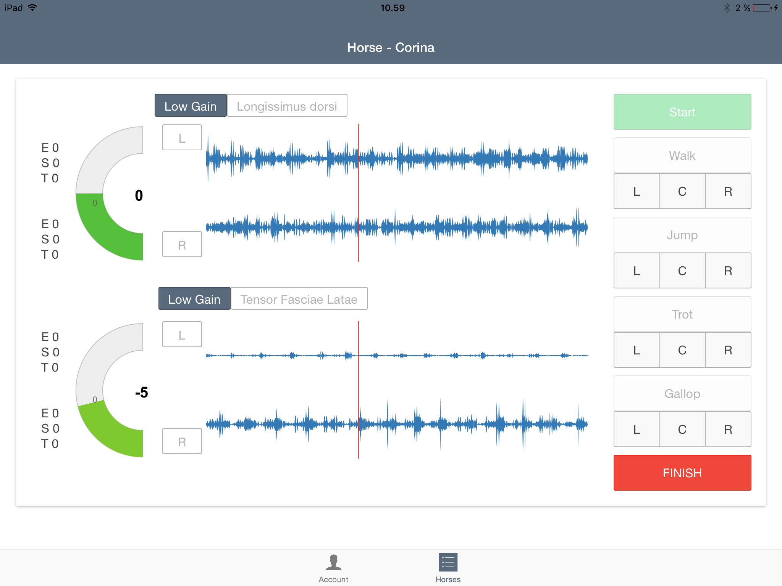
CURO RECORDING (1)
The Horse page should now look like this.
On the left hand side you will see two columns of letters (E S T) this is the ESTiTM Score that the CURO generates for each sensor (muscle) when a recording is started. Until a recording is started the values will remain at 0.
Next to the ESTiTM Score is a semi-circle with the Balance Score – the green bar will move and change colour to represent the degree of balance between the two sensors (muscles) as the recording starts and the subject starts to become physically active.
In the middle of the screen you can see the L (left) and R (right) traces which reveal the acoustic myography signal in real-time.

Slide 23
CURO RECORDING (2)
When you press the green Start button on the far right of the iPad screen, the acoustic myography data from the sensors and the CURO will begin to stream in real-time.
When you are happy that your subject is performing correctly, press the choosen gait button fx. Walk L in the panel – this will start a recording and a green line will appear on the trace. The button will also change shape to a darker grey. The ESTiTM Score will now become active and you will see calculated values for the three parameters in real-time.
Record the subject’s activity for about a screens length (or shorter if you prefer), and when you are ready, press the gait button again to stop the recording - when the recording is stopped, a red line will appear on the trace.
When you are ready, press the red Finish button at the far right of the iPad screen, and the measurement session will end.

Slide 24
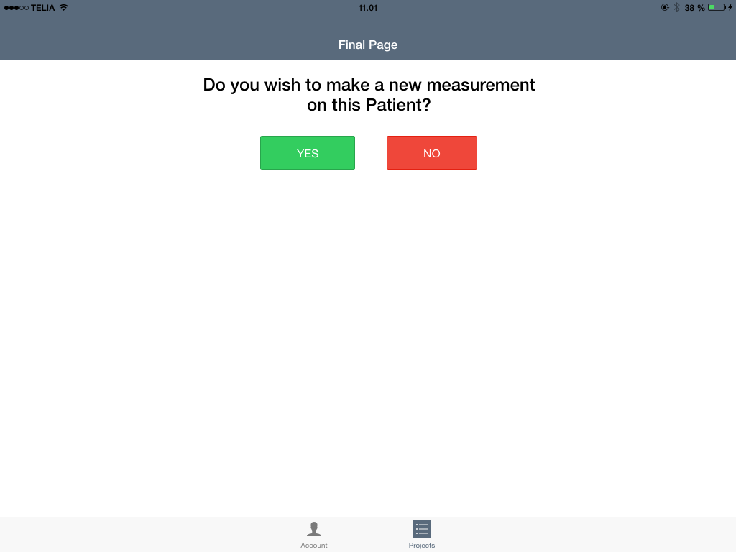
CURO RECORDING (3)
The Final Page allows you to select a new measurement on the same horse, or to end the measurement session.
If you press the green YES button, you will be taken to the muscle selection page and asked to select a new muscle group for measurement.
If you press the red NO button, you will be taken back to the horse page.

Slide 25
CURO RECORDING (4)
Remember to transfer your measurements from your Horses to your Client Cloud Account.
Make sure that you have switched off the WiFi connection on your iPad and that you have an internet connection (SIM card) or that the iPad I connected to a very strong and stable WiFi source (not the CURO).
Press the double arrow circle at the top left hand corner of the Horse page and you will Sync your data with your Client Cloud.
  NOTE: this process can take a few minutes if you have a weak internet link or you have made numerous measurements.
You can now Log Out of the CURO Equine App, or continue to perform a new measurement if you so wish.

Slide 26





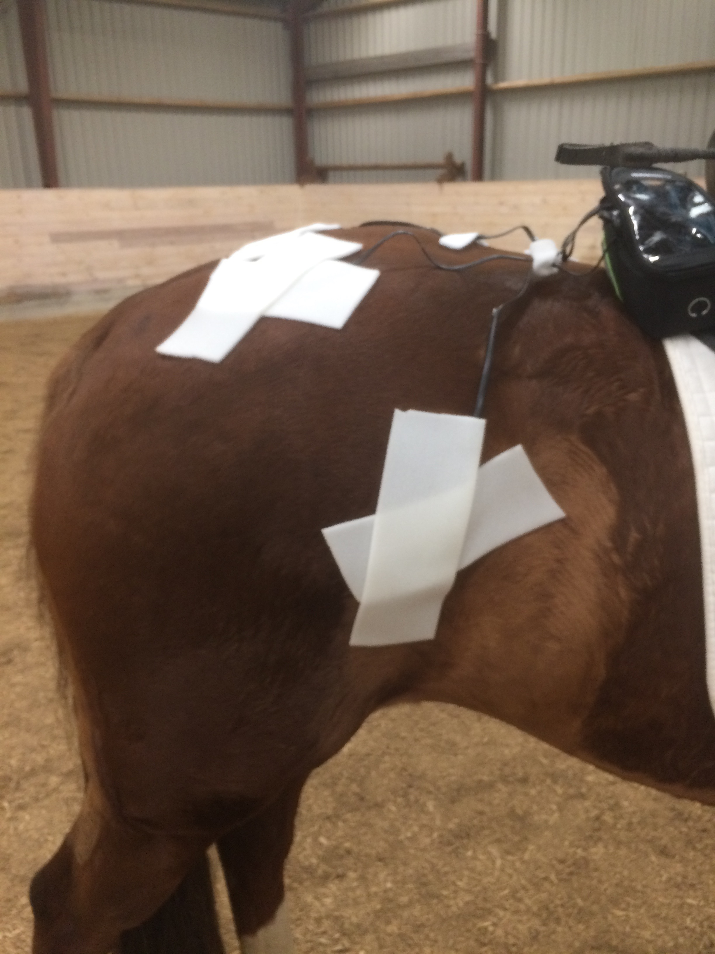
Signals, up-loads & data treatment pathways
WiFi signal
CURO
Sync
Cloud
synchronisation
Recorded sound
Automatic download
iPAD
Up load
Saved file
http://curo.softheme.com/horse/index

Slide 27
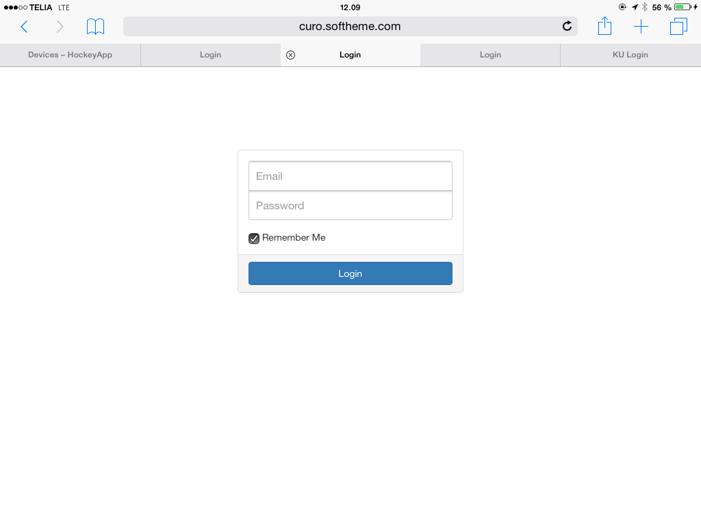
CLIENT CLOUD ACCOUNT (1)
Every CURO user has a Client Cloud Account where their recorded data can be held, shared and managed.
You Log In to your Client Cloud at:
https://app.myodynamik.com/site/login
You use your assigned E-mail and your Password and press the blue Login button.
You can gain access from any computer around the World, and even share your access with colleagues if you so wish.

Slide 28
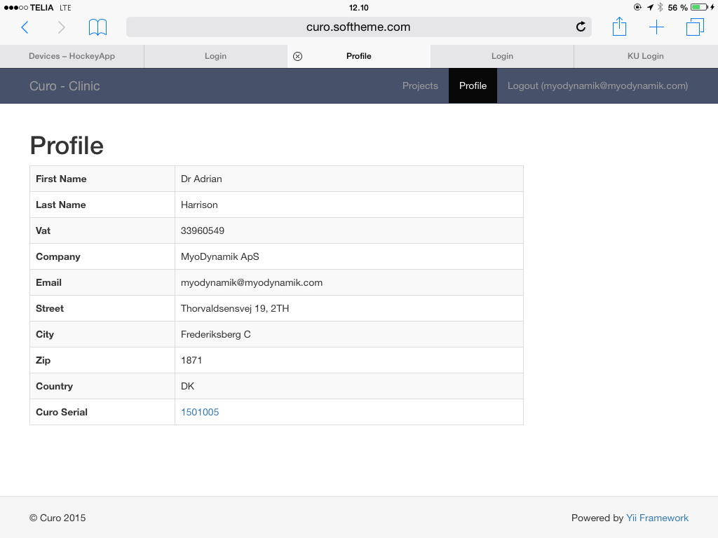
CLIENT CLOUD ACCOUNT (2)
Your Client Cloud Account can also be accessed on any iPad or iPhone providing they support an internet connection and site access.
You can see your Profile and your Horses.

Slide 29
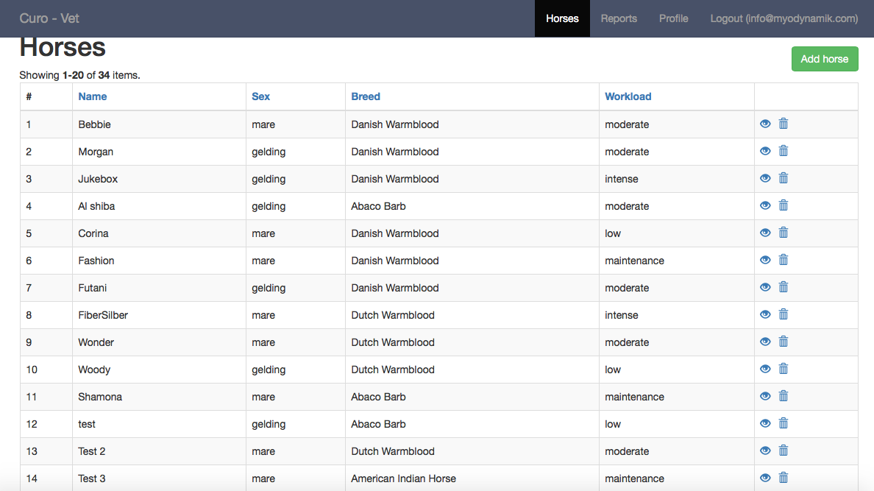
CLIENT CLOUD ACCOUNT (3)
The Horses that you have set up using the CURO Equine App on your iPad, and have sync’ed will be listed here.
In addition, you can check on the data you have collected and transfer any WAV files you recorded using the CURO directly.
  NOTE : This requires a PC or Mac Computer, since the format is not currently iPad friendly.
If you touch the blue eye icon for an individual horse, you will be shown the current status of your measurements.
  MyoDynamik ApS takes no responsibility for users not following the laws concerning personal data.

Slide 30
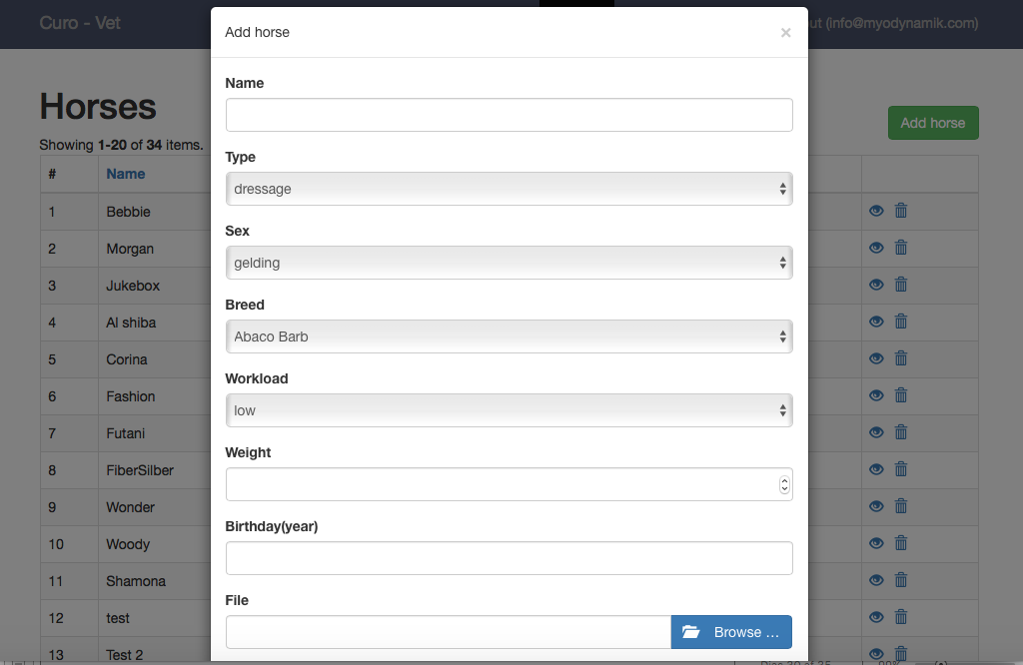
CLIENT CLOUD ACCOUNT (4)
You can add a horse to the curo.softheme.com system.
Press the Add horse button and fill out each of the information blocks (you can not leave any of the spots blank).
You can also add a picture.

Slide 31
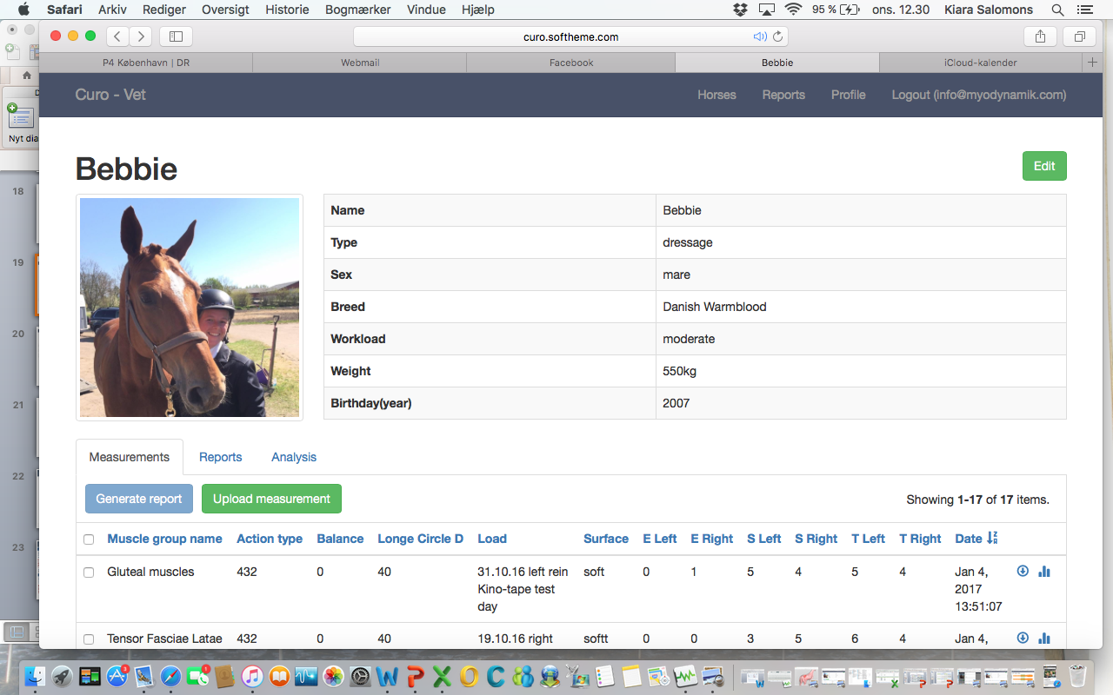
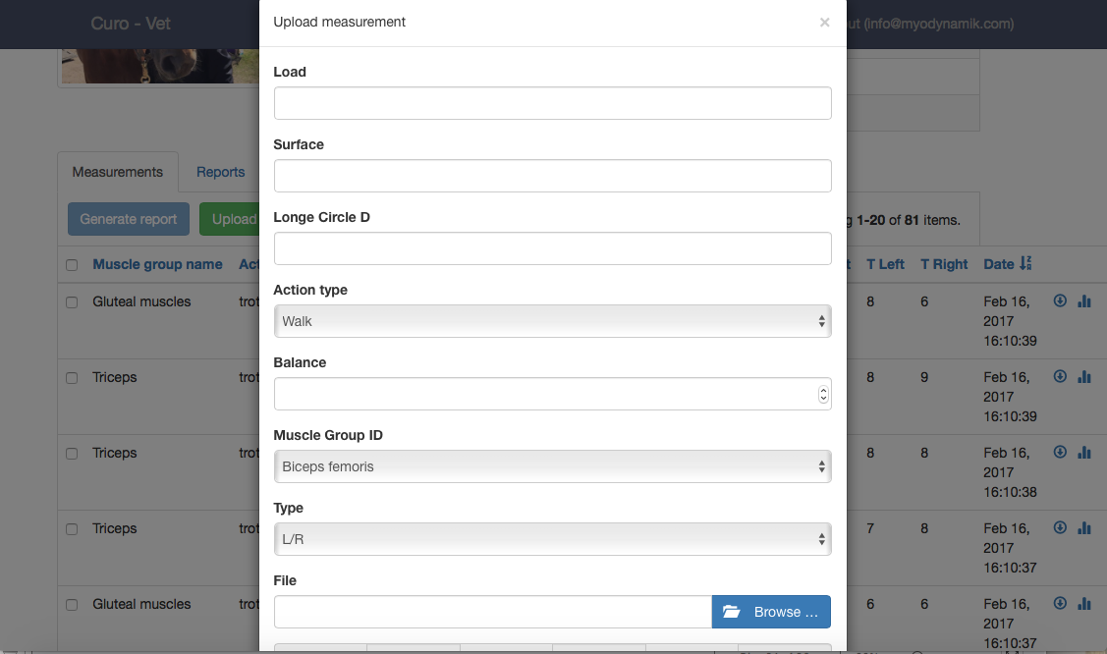
CLIENT CLOUD ACCOUNT (5)
You can add a WAV file for a specific horse in the curo.softheme.com system. A WAV file is created directly on the CURO when you press the red “Record” button.
Click on the horse for which you want to add a measurement, and then press upload measurement and type in information for each of the blocks (you can not leave any of the spots blank).
You can choose to use the “load” spot to type in information about the measurement you have made, e.g. training, jumping.
Click on browse and select your WAV file. Press upload.

Slide 32
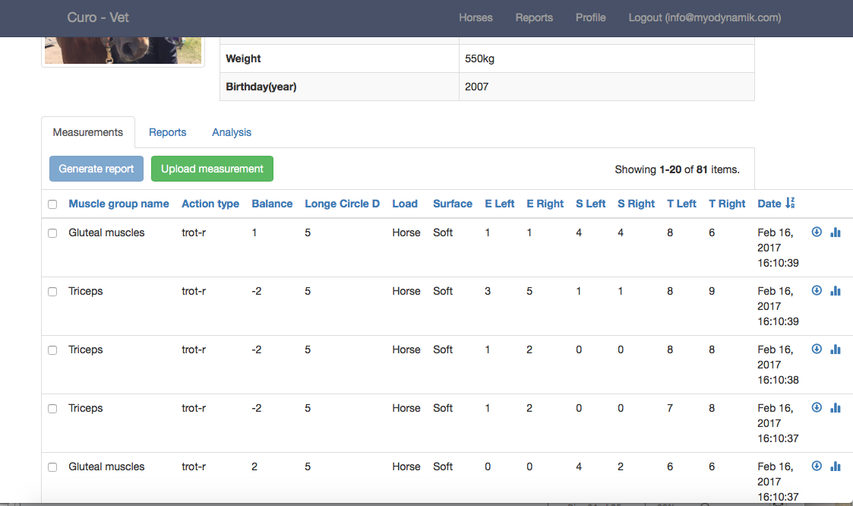
CLIENT CLOUD ACCOUNT (5)
If you click on the individual Tests, you will be presented with the recorded data – Balance and ESTiTM Scores.
Details of the individual Tests can subsequently be transferred to a database or spreadsheet (copy / paste), or you can touch the blue arrow icon on the right hand side of the ESTiTM data to download the WAV file or obtain CSV data for this recording.
WAV or CSV files can be analyzed using commercial software, or saved as a record of the Horse and Tests performed.

Slide 33
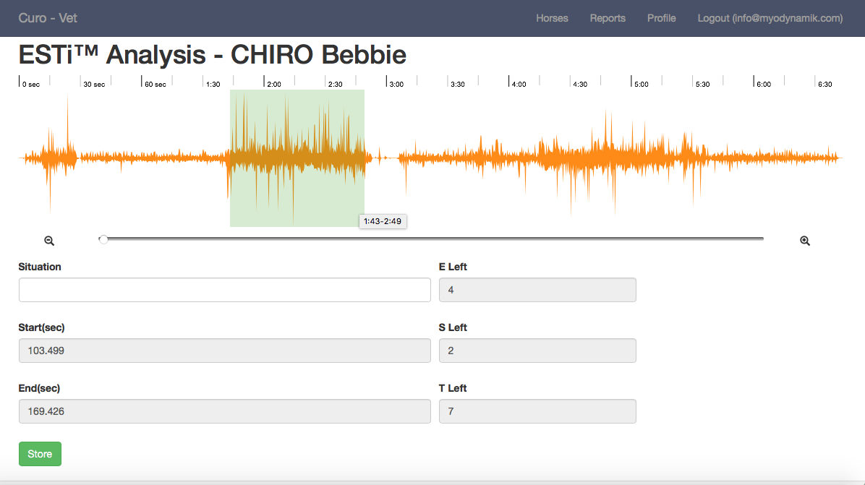
CLIENT CLOUD ACCOUNT (6)
Detailed analyses of individual Tests can be performed using the Client Cloud software.
Press the blue column graph icon (far right of a measurement line).
Now you will be shown the detailed recording, and you can highlight a section – e.g. a trot section, using the green bar. The green bar can be altered (wider/narrower) by pulling it at the edges.
You can also zoom in or out of the recording using the sliding bar below the recorded data.
An ESTi score will appear – indicating E, S & T values – assuming they are within standard norms.

Slide 34
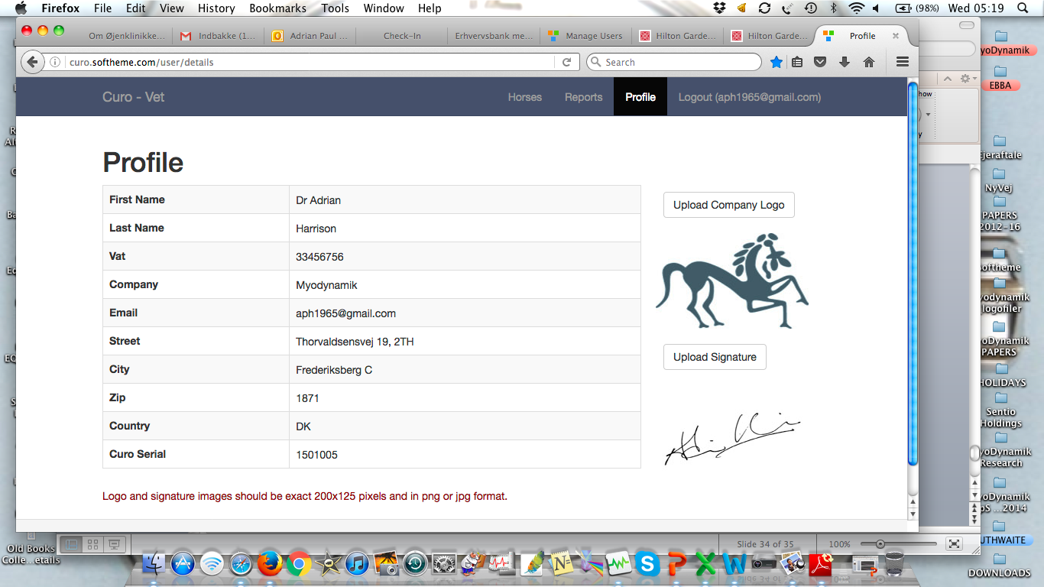
CLIENT CLOUD ACCOUNT (8)
Finally, when you are finished using your Client Cloud, you click the Logout text at the top right hand corner of your CURO – Vet tool bar, and you will exit the Client Cloud.

Slide 35
PROBLEMS - TROUBLESHOOTING
Cannot login – wrong e-mail address or password (check these are filled out correctly)
CURO Equine App will not download – check that your iPad is running iOS 8.0 or more recent iOS
No muscles visible in the App – check that WiFi is OFF and that you have a SIM card installed in your iPad with a functional internet connection
A failure to Sync measured data – check that you have switched the WiFi OFF on the iPad and that you have a strong internet signal (SIM card) – this function may take a while if you have a weak internet or a lot of data to transfer.
The WiFi signal has a range of 100 meters – but as with any internet signal this distance is reduced if there are solid objects in the way of the CURO and iPad – the signal can also be affected by a smart phone with an active WiFi connection (set your smart phone to flight mode)
Make sure that the CURO is fully charged before starting a number of measurements on Horses. A CURO with less than 50% battery can function for a couple of hours, but a loss of power will prevent data recording.
Do not expose the CURO to extremes of temperature – on a hot day, a warm room or direct sunlight, a rise in temperature will affect the WiFi connection with the iPad and may cause a loss of connectivity. On cold days the battery will fail faster than on an ambient day – wrap the CURO in bubble wrap or something similar to keep it warm.

